Slide 1

Job Evaluation
Old, Bold or a Story Untold
Marcus Downing
Hay Group
Notes:
Personal introductions
Context from Clive
Mediums: acetates and flipcharts
Materials: slides and je materials
Expectations and previous experience of je

Slide 2
Content
What is Job Evaluation?
Job Evaluation Processes and Guidelines
Job Evaluation and Pay
Setting Reward Structures Using Job Evaluation
Job Evaluation and Salary Management
Job Evaluation Benefits
Job Evaluation Risks and Considerations
Notes:
Split half and half

Slide 3


What is Job Evaluation?

Slide 4
What is Job Evaluation?
Job Evaluation is a systematic process for ranking or rating jobs logically and fairly by
comparing job against job or against a pre-determined scale to determine the relative importance of jobs to an organisation.
Which is to say that Job Evaluation … …
IS
Comparative
Judgemental
Structured
Job Centred
IS Not
Absolute
Scientific
Unstructured
Person Focused
Notes:
Hay is just one method
All to do with relativities: internally and externally

Slide 5
Possible Applications for Job Evaluation
JOB EVALUATION
Reward
Grading
Succession Planning
Career Development
Organisational Analysis
Link to market data
Underpin the framework
Understand relationships between roles
Identifying ‘gaps’ in the structure
Understanding possible career paths
Notes:
Prime use is for pay
Other secondary uses
Your own application is through pay

Slide 6
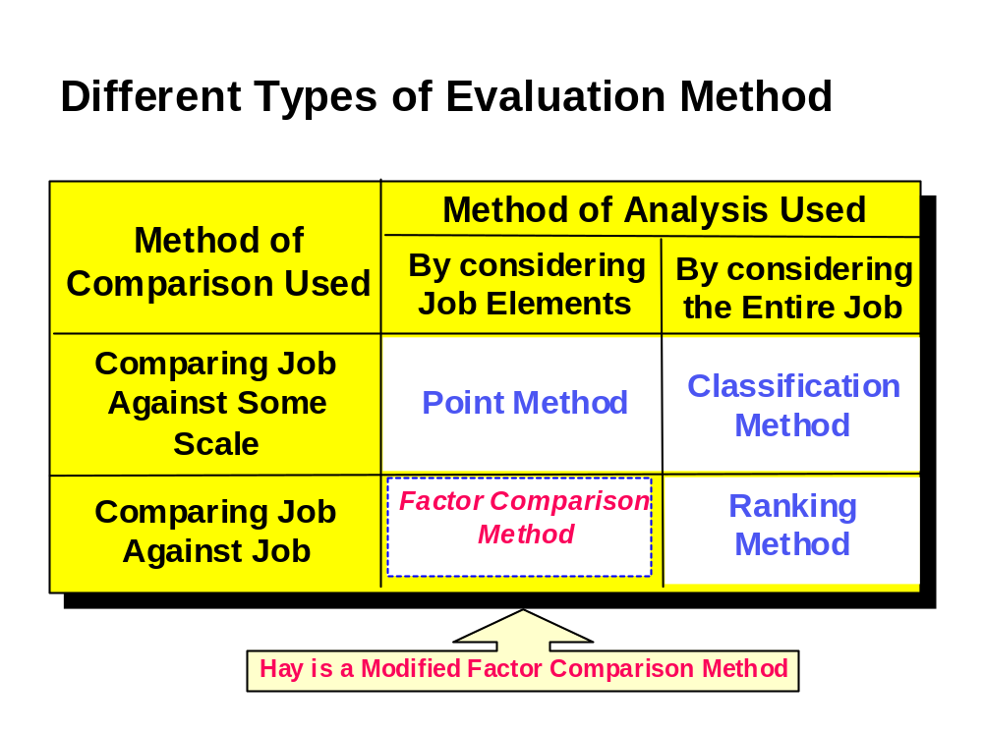
Notes:
Prime use is for pay
Other secondary uses
Your own application is through pay

Slide 7
Job Ranking
Arsenal
Bolton
Chelsea
Total
Rank
Arsenal
X
3
3
6
1
Bolton
0
X
0
0
3
Chelsea
0
3
X
3
2

Slide 8
Job Ranking
Chief Executive
HR Manager
Total
Rank
Security
Chief Executive
X
3
3
6
1
HR Manager
0
X
3
3
2
Security
0
0
X
0
3

Slide 9
Notes:
Prime use is for pay
Other secondary uses
Your own application is through pay

Slide 10
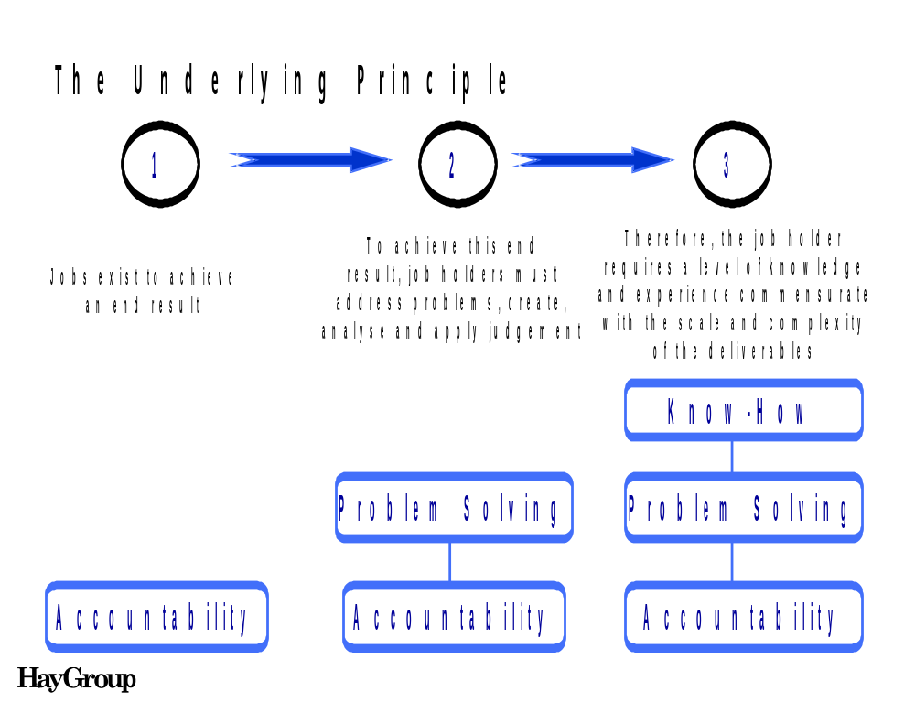

Slide 11
Elements of Sizing
TOTAL SIZE
KNOW-HOW
+
PROBLEM SOLVING
+
ACCOUNTABILITY
=
Depth & Range
of
Know-How
Planning &
Organising
Communicating &
Influencing
Freedom
to Act
Nature of
Impact
Area of
Impact
(Magnitude)
Thinking
Environment
Thinking
Challenge

Slide 12
Notes:
Prime use is for pay
Other secondary uses
Your own application is through pay

Slide 13
LEVEL
1 | 5 | 16 | 6 | 6 | 6 | 4 | 5 | 5 | 5 | 4 | 5 | 5 | 3 | 3 | 5 | 3
2 | 12 | 36 | 15 | 15 | 15 | 9 | 12 | 12 | 12 | 9 | 12 | 12 | 7 | 7 | 11 | 7
3 | 21 | 60 | 27 | 27 | 27 | 15 | 21 | 21 | 21 | 16 | 21 | 21 | 12 | 12 | 18 | 12
4 | 32 | 88 | 42 | 42 | 42 | 22 | 32 | 32 | 32 | 24 | 32 | 32 | 18 | 18 | 25 | 18
5 | 45 | 120 | 60 | 60 | 60 | 30 | 45 | 45 | 45 | 34 | 45 | 45 | 25 | 25 |  | 25
6 | 60 | 156 |  |  |  | 39 | 60 | 60 | 60 | 46 | 60 | 60
7 |  | 196 |  |  |  | 49 |  |  |  | 60
8 |  | 240 |  |  |  | 60
10. Responsibility – Information resources
9. Responsibility – Staff/HR leadership, training
1. Communication & relationship skills
8. Responsibility – Financial and physical
7. Responsibility – Policy and service
2. Knowledge, training & experience
6. Responsibility – Patient/client care
15. Emotional effort
4. Planning and organisation skills
12. Freedom to act
14. Mental effort
11. Responsibility – R&D
13. Physical effort
16. Working conditions
3. Analytical skills
5. Physical skills

Slide 14
Notes:
Prime use is for pay
Other secondary uses
Your own application is through pay

Slide 15
Job Classification
Slot jobs into grades by comparing whole job with a scale in the form of a hierarchy of grade definitions
The Process
Number and characteristics of grades are defined
Grade definitions to include factors like skills, experience, accountability
Usually only a few grades (differentiation a problem if too many)
A | Xxxxxxxx
B | Xxxxxxxx
C | Xxxxxxxx
D | Xxxxxxxx
Notes:
Prime use is for pay
Other secondary uses
Your own application is through pay

Slide 16
Job Evaluation Processes
and Guidelines

Slide 17

Guidelines in Job Evaluation
The job as it is now
Notes:
Need to keep in mind at all times
Give example of WWF

Slide 18
Guidelines in Job Evaluation
Fully acceptable Performance
The job as it is now
Notes:
Need to keep in mind at all times
Give example of WWF

Slide 19
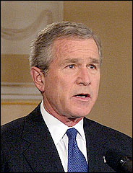

Slide 20
Guidelines in Job Evaluation
The Job & NOT the Person
Fully acceptable Performance
The job as it is now
Notes:
Need to keep in mind at all times
Give example of WWF

Slide 21
Guidelines in Job Evaluation
The Job & NOT the Person
Aim for
Consensus
Fully acceptable Performance
The job as it is now
Notes:
Need to keep in mind at all times
Give example of WWF

Slide 22


Slide 23
Guidelines in Job Evaluation
The Job & NOT the Person
Aim for
Consensus
Fully acceptable Performance
Disregard current pay & status
The job as it is now
Notes:
Need to keep in mind at all times
Give example of WWF

Slide 24
Guidelines in Job Evaluation
The Job & NOT the Person
Aim for
Consensus
Fully acceptable Performance
Disregard current pay & status
The job as it is now
No understanding No Evaluation
Notes:
Need to keep in mind at all times
Give example of WWF

Slide 25
Jobs Exist In A Context
Changes to one job affect those around them
  jobs are intimately related to those around them

Slide 26
Job Family Evaluation Process
Business
Input
Job Information
Business
Information
Judgement
Record of
Reasons
Apply Conclusions
Evaluation
Method
Review

Slide 27
Job Evaluation and Pay

Slide 28
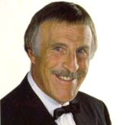
The All–Time Enemy of Job Evaluation……..

Slide 29
Some factors influencing pay
Internal relativity
Market
Comparison
Profit Share
Dept. Performance
Individual Performance
Pay
Pay “heritage”
Job size
Market
Positioning
Company Performance
Length of service

Slide 30
Setting Reward Structures Using JE

Slide 31
Setting Up Reward Structures for Base Pay
JOB ANALYSIS
Job Descriptions
JOB EVALUATION
Process
Methodology
Results
REWARD STRUCTURE
Number
Width
Positioning
PAY STRUCTURE
Policy
Practice
Ranges
PAY PROGRESSION
Market Positioning
Corporate Performance
Individual Performance

Slide 32
Job Families
A job family describes a number of roles which are engaged in a similar or related kind of work.
Job family modelling is a process of work analysis and definition which identifies the levels within a family, and defines accountabilities, performance measures and skills for each level of work.
A completed job family considers how many levels of that type of work there are and describes the key factors which differentiate one level from the next.

Slide 33
Using Job Evaluation to Size Job Families
Job Family
Generic Level A
Generic Level B
Generic Level C
Generic Level D
Generic Level E
Job Family Levels
Accountabilities
…………….
…………….
…………….
Performance Criteria
…………….
…………….
…………….
Evaluation Scores
Knowledge & Skills
…………….
…………….
…………….

Slide 34
Using Job Evaluation to Size Job Families
Levels Defined
Using
Chosen
Evaluation
Methodology
JFM 1
JFM 2
JFM 3
JFM 4

Slide 35
Using Job Evaluation to Set Grading Structures
Finance & IT
Finance
Director
Financial Controller
Systems Mgr
Tech Mgr
T, F, H&S
Mgr
Credit Control
Mgr
Systems Analyst
Asst Developer
IT Support
Asst
T, F H&S
Asst
Finance Admin
Finance
Asst

Slide 36
Using Job Evaluation to Set Grading Structures
Finance & IT
Finance
Director
Financial Controller
Systems Mgr
Tech Mgr
T, F, H&S
Mgr
Credit Control
Mgr
Systems Analyst
Asst Developer
IT Support
Asst
T, F H&S
Asst
Finance Admin
Finance
Asst

Slide 37
Using Job Evaluation to Set Grading Structures
Finance & IT
Finance
Director
Financial Controller
Systems Mgr
Tech Mgr
T, F, H&S
Mgr
Credit Control
Mgr
Systems Analyst
Asst Developer
IT Support
Asst
T, F H&S
Asst
Finance Admin
Finance
Asst

Slide 38
Using Job Evaluation For
Salary Management

Slide 39
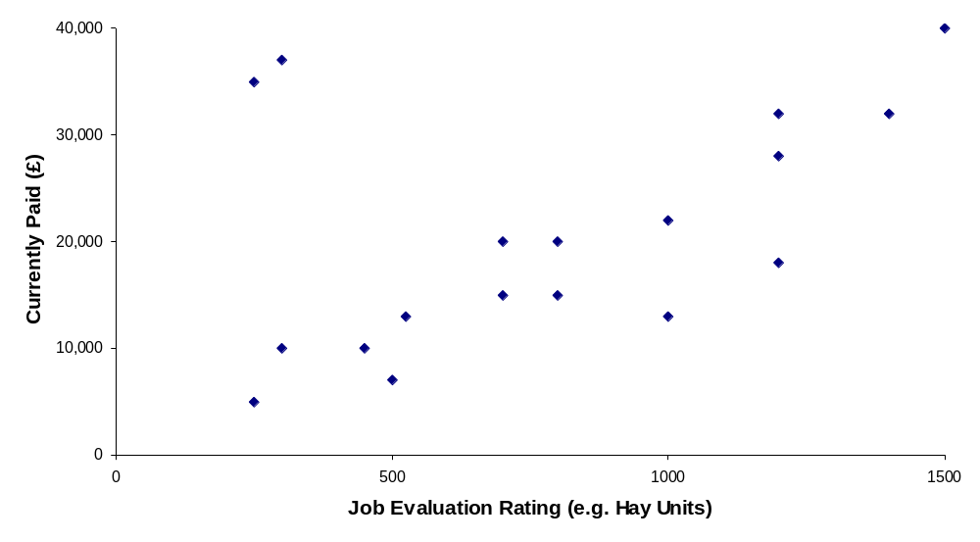
%

Slide 40
JE Benefits

Slide 41
Possible Benefits
A structured framework for pay and grading
Greater clarity and transparency for employees
Identify and tackle anomalies
Improved fairness and better equal value protection
Access to market data to inform cost effective decisions on pay

Slide 42
Possible Benefits (2)
Sensitive in measuring job differences
Enables comparison of dissimilar jobs
Enables benchmarking against jobs outside the organisation as well as reflecting hierarchies internally
Is able to reflect jobs as they change with time
Help to improve recruitment and retention for targeted areas within your business
Provide clear development pathways for your employees

Slide 43
JE Risks and Considerations

Slide 44
Possible Risks
Fears that salary costs will rise
Administrative/process costs rise
There is no fit with the strategic agenda
There are no positive benefits for stakeholders
The organisation takes on too much

Slide 45
Implementation Considerations
the need for and possible problems in getting union involvement
the need for and problems in getting wider business involvement
the need to have appeals processes which do provide a safety valve but don't take up a lot of time
the critical nature of communications to success

Slide 46
Implementation Considerations (cont…)
the requirement to look closely at the new pay policy: what to pay for; the role of increments and the basis for progression etc
the difficulties of getting managers to buy in to a new way of working, and of raising their capability to deal with pay and performance processes
the fact that all this attention to grading and pay will raise expectations, and so the big risk is that change leaves large numbers disappointed.

Slide 47
Questions

Slide 48
Contact/Presentation details
Marcus Downing
Hay Group Ltd
0788 411 0669
0207 856 7027
Marcus_Downing@Haygroup.com
http://www.haygroup.co.uk/Events/Events.asp

